Slide 1
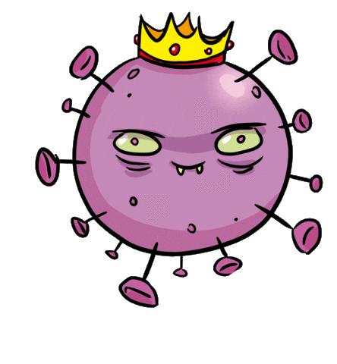
Did you do your homework?
Sure thing!

Slide 3
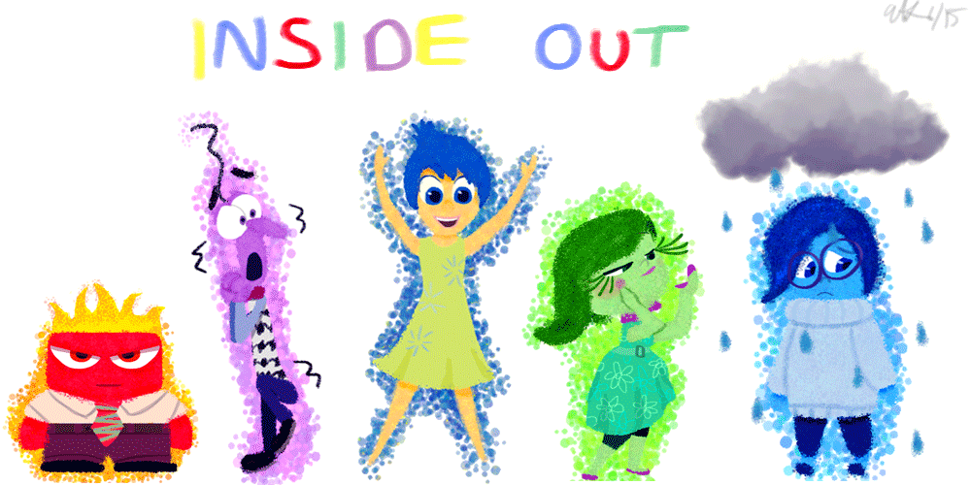
Joy
Fear
Sadness
Disgust
Anger

Slide 4
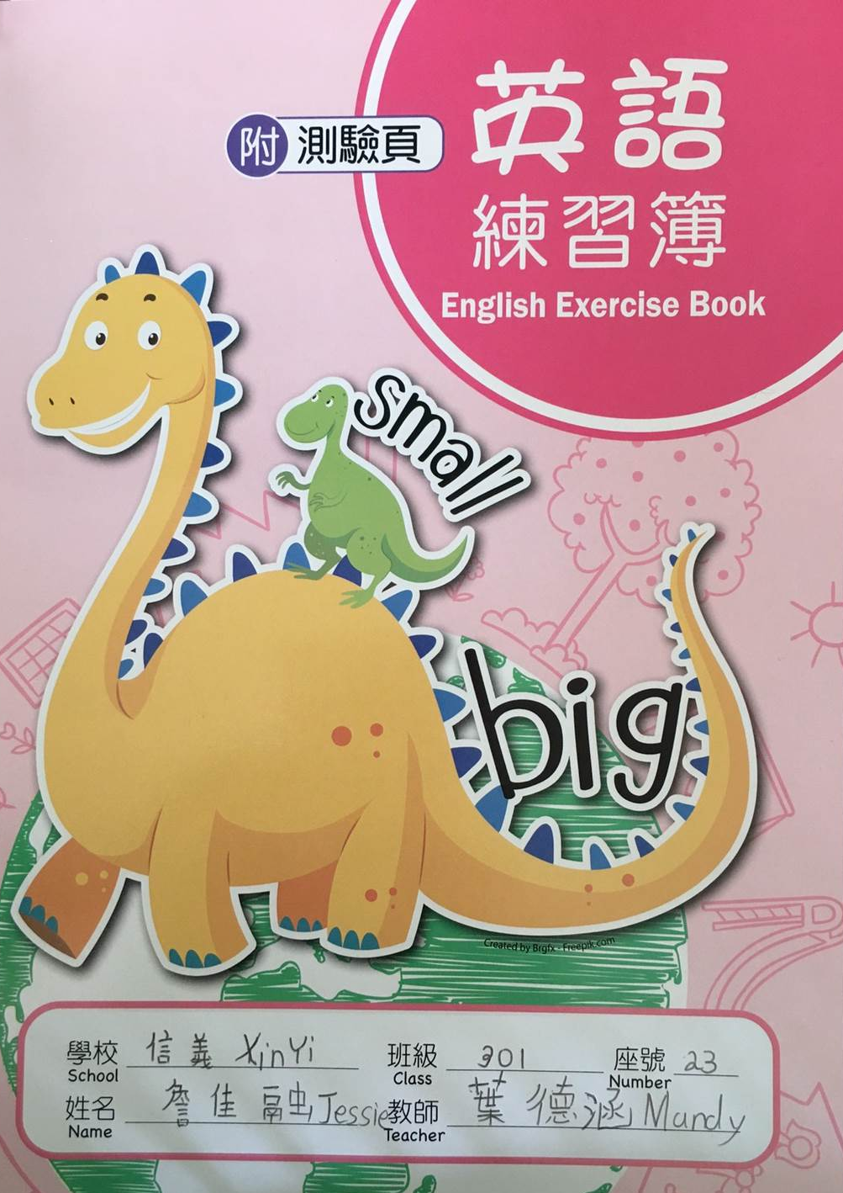
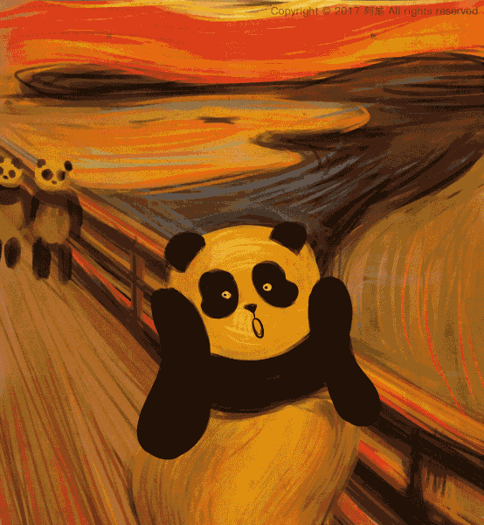

Slide 5
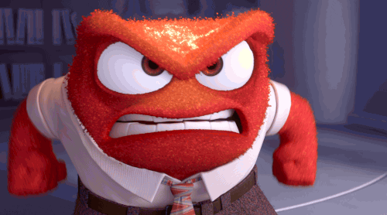
angry
mad
piss off
hit the ceiling

Slide 6
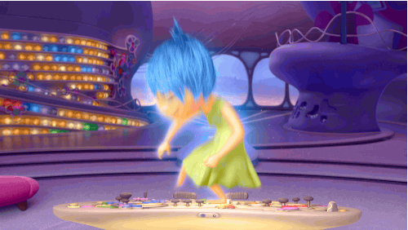
happy
glad
joyful
over the moon

Slide 7
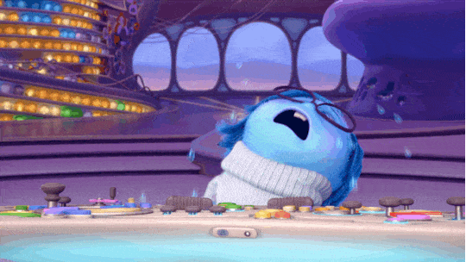
sad
down
blue
in a bad mood

Slide 8
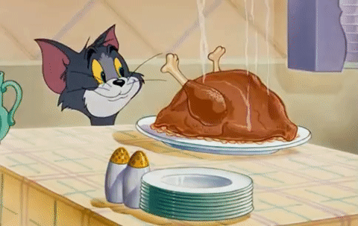
hungry
starving
I could eat a horse.

Slide 9
thirsty
parched
I’m drier than the desert.

Slide 10
sick
have a cold
I'm not feeling well.

Slide 11
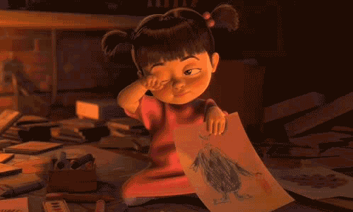
tired
sleepy
feel dog-tired

Slide 12
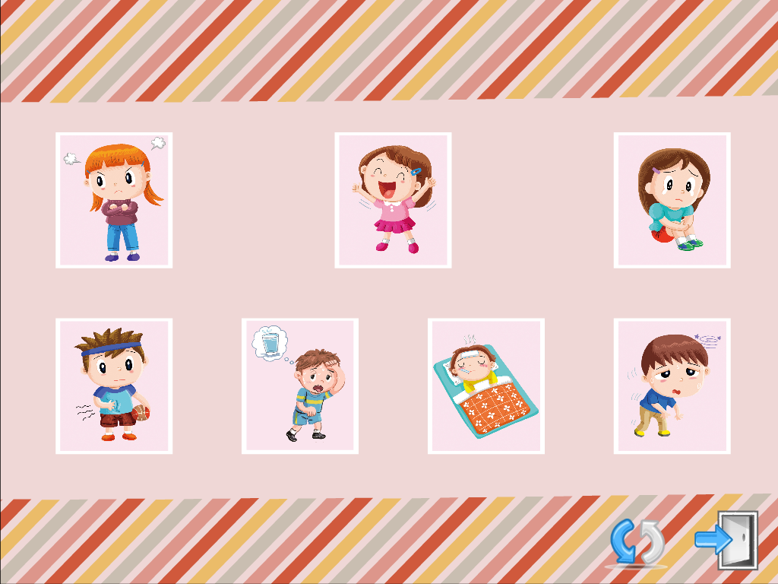
angry
happy
sad
hungry
thirsty
sick
tired

Slide 13
1
angry
2
happy
3
sad
4
hungry
5
thirsty
6
7
tired
sick

Slide 14
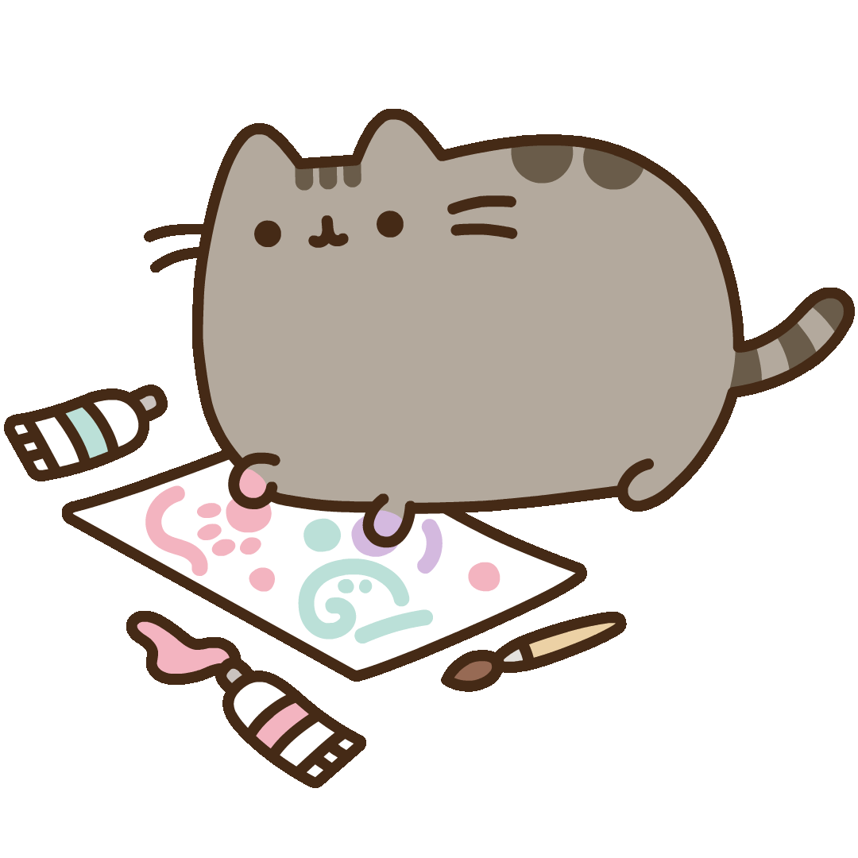
The great Designer

Slide 15
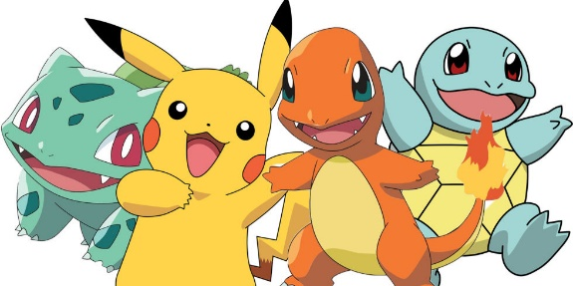
Homework this week
聽: CD1第22-25首。
說&讀:聽CD時跟著大聲唸。完成3遍
請家長在課本P14簽名可換印章。
寫: 完成英語練習簿Unit 1單字，每個
4遍，鼓勵表情貼圖創作，下週一交。

